Slide 1
Intro to Probability
or:
why you would care about
set theory

Slide 2
Man I hear this word all the time I wonder what it means?
What can you do?

Slide 3
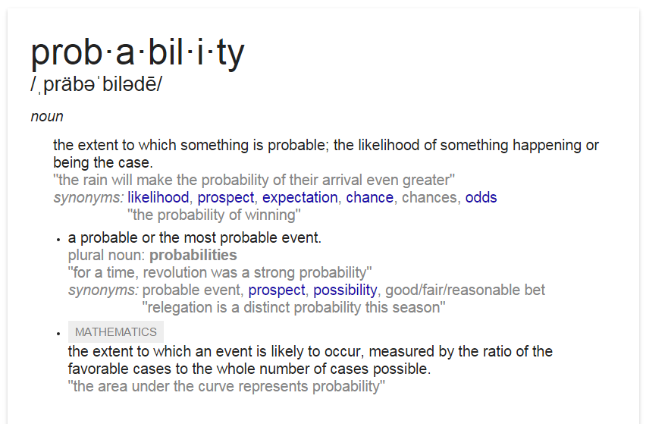
What is Probability?
(Google?)

Slide 4
What’s an Event?
(get a book?)

Slide 5
What’s all that?
(get a book?)

Slide 6
Okay… in English this time?
(get a math translator!)
What’s something we have heard the word “probability” with before?
Sports
Dice
Coins
Gambling

Slide 7
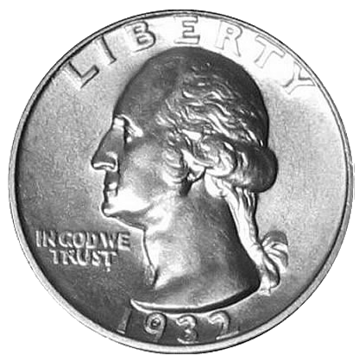
What’s the probability of getting Heads?
Well What could happen when I flip a coin?
(these are called outcomes)

Slide 8
Can anything else happen?

Slide 9
This is why we use the word experiment!
Definition:
An Experiment is a controlled “action” with only certain possible outcomes.
Example: flipping a coin, rolling dice, picking a card, etc.

Slide 10
Probability Space
Definition:
The set of all possible outcomes of an experiment is called the probability space.
(This is our universe)

Slide 11
Examples:
(one can “tell the difference” between the two coins)
Experiment: You flip two distinguishable coins.
Outcomes: ( , ), ( , ),..., ( , ) (How many?)
( H , H ), ( H , T ),..., ( T , H )
Sample Space
S=
(H,H)
(T,H)
(H,T)
(T,T)

Slide 12
Examples:
(one cannot “tell the difference” between the two coins)
Experiment: You flip two indistinguishable coins.
Outcomes: ( , ), ( , ),..., ( , ) (How many?)
( H , H ), ( H , T ),..., ( T , H )
Sample Space
S=
(H,H)
(T,H)
(H,T)
(T,T)

Slide 13
Examples:

Slide 14
Examples:

Slide 15
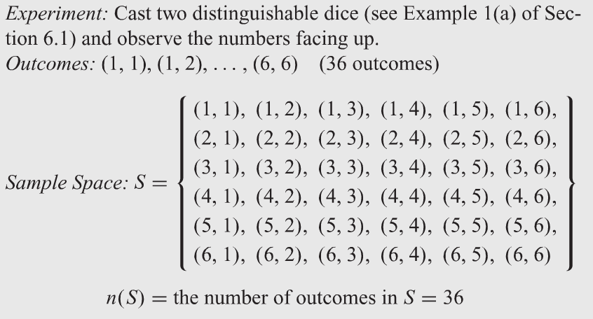
Examples:

Slide 16
Examples:

Slide 17
So What’s an Event?
Definition: An Event is subset of the probability space.

Slide 18
Example
(Coins!)
Event: “getting heads”

Slide 19
Mutually Exclusive Events
Hey this is a definition!!!
It means they are disjoint

Slide 20
So What’s Probability?
There are various philosophical views to as to what we should mean by “actual” probability.
(so let’s not go there!)

Slide 21
So What’s (abstract) Probability?
(Each outcome is equally likely)
Read: “The probability of oberving event E”

Slide 22
Example
A total of 1.9 million hybrid vehicles had been sold in the United States through October 2011. Of these 955,000 were Toyota Prius; 205,000 were Honda Civics; 170,000 were Toyota Camrys; 105,000 were Ford Escapes; and the rest were different makes
What is the probability that a hybrid vehicle sold in the united states was a Toyota Prius?

Slide 23
Example
A total of 1.9 million hybrid vehicles had been sold in the United States through October 2011. Of these 955,000 were Toyota Prius; 205,000 were Honda Civics; 170,000 were Toyota Camrys; 105,000 were Ford Escapes; and the rest were different makes
b) What is the probability that a hybrid vehicle sold in the united states was a Toyota Prius or a Ford Escape

Slide 24
Group Work:
If you have 4 red marbles, 3 green marbles, and 5 blue marbles (all distinguishable from each other) what is the probability of drawing 4 red marbles?
There are 18 boys and 17 girls in a class, what is the probability a randomly selecting 1 girl?
A bag of candy contains 10 red candies, 7 blue candies, and 5 orange candies, what is the probability of drawing one candy randomly and not getting an orange?
The police line up 10 people in an identity parade; only one of the people is the criminal. A witness does not recognise the criminal and so chooses a person at random. What is the probability they didn’t choose the criminal?
(SL)
(RC)
(GR)
(HP)

Slide 25
Let’s look at the marble question...
What is the sample space???

Slide 26
Can we do an easier one first?
What is the probability of pulling just one red?

Slide 27
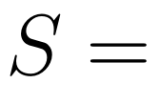
Can we do an easier one first?
What is the sample space?

Slide 28
Can we do an easier one first?
What is the event?
They seem like they are distinguishable???

Slide 29
Let’s look at the marble question...
Back to pulling 4 marbles!
How many are there?

Slide 30
Let’s look at the marble question...
Pulling 4 marbles is the experiment!
Does order matter?

Slide 31
Let’s look at the marble question...
Let’s do the event first!
(
,
,
,
)
1

Slide 32
Can we do an easier one first?
What is the sample space?
(
)
,
,
,
(
,
,
,
)
…

Slide 33
Set Theory is GREAT!
So in a statistics and probability class they give you all of these formulas:

Slide 34
Seriously set theory is great!
But we don’t need formulas we just know how to count!

Slide 35
Seriously set theory is great!
But we don’t need formulas we just know how to count!

Slide 36
Seriously set theory is great!
This one is
seriously important!
But we don’t need formulas we just know how to count!

Slide 37
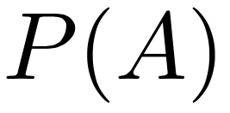
Example (this would be hard for a probability student but really easy for you!)
Given:
Find:

Slide 38
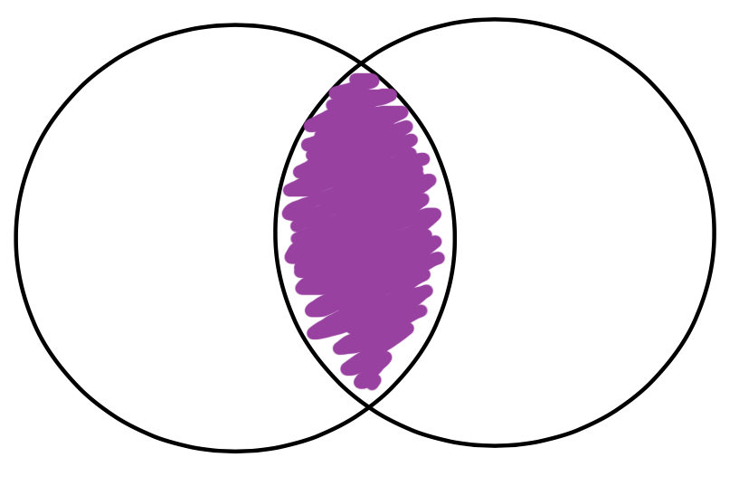
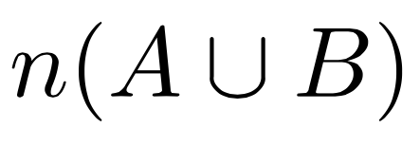
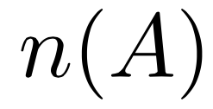
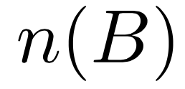
Example
Recall:

Slide 39
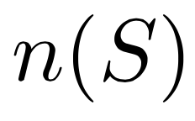
Example

Slide 40
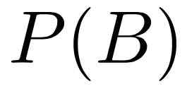
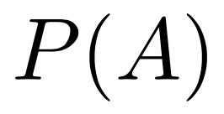
Example

Slide 41
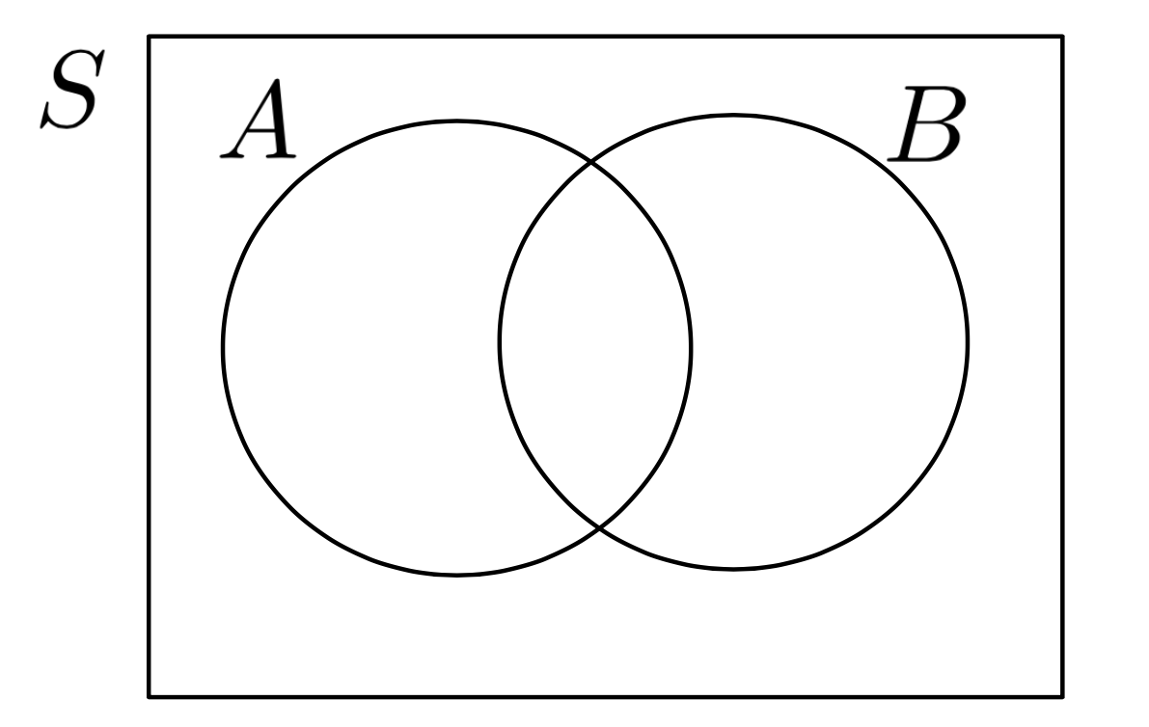
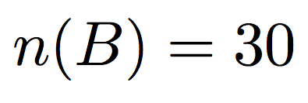
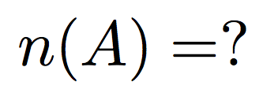
Have we done this before?

Slide 42
Group Work:
(GR)
(RC)
(HP)
(SL)

Slide 43
Abstract v.s. Relative Probability
Abstract Probability (this lecture) is for me
Relative probability (next lecture) is for the business majors!

